Slide 1
Data Visualisation
Real Estate Price Prediction Project – Data Analysis

Slide 2
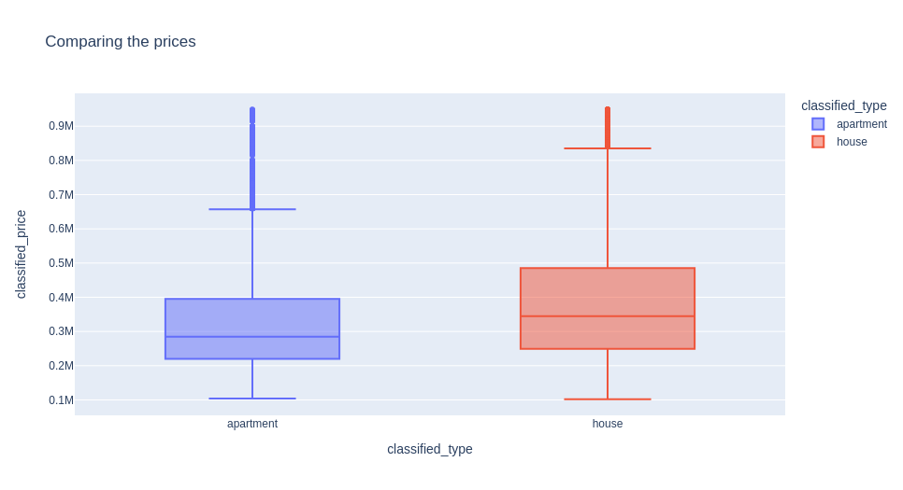
Comparing the prices
As expected, it was observed that price of houses is greater than price of apartments.

Slide 3
Correlation between prices and the number of bedrooms
Hypothesis 1 –
The mean value of price does not change with change in the number of bedrooms
Hypothesis 2 –
The mean value of price varies with the change in the number of bedrooms
One - way ANOVA

Slide 4
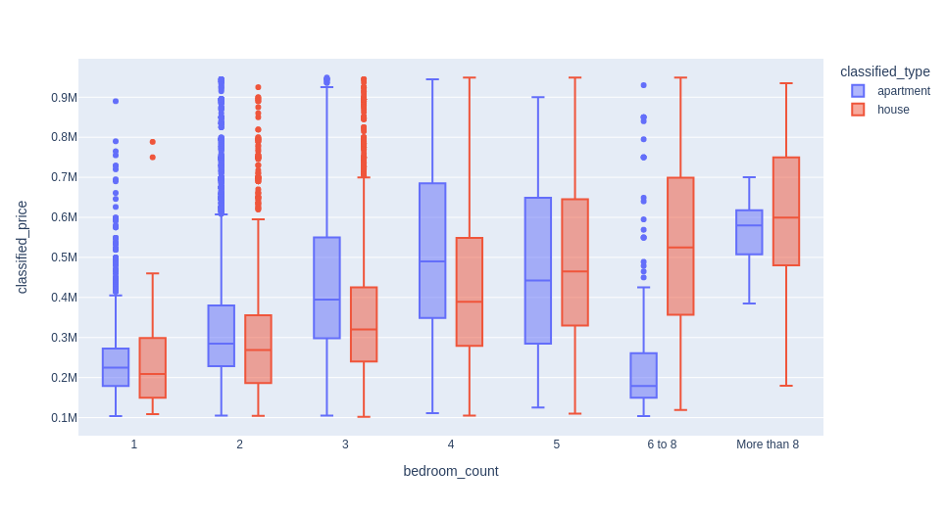
Price varies based on the number of bedrooms
Prices increases with an increase in the number of bedrooms

